Slide 1
ANNAMACHARYA INSTITUTE OF TECHNOLOGY & SCIENCES, KADAPA
A Novel 8-Transistor Full Adder using CNTFET
ICICNIS-1078
Presented by:
P. SRUTHI

Slide 2
INTRODUCTION
VLSI systems require low power and high speed due to high integration density
Reducing transistor count is important to minimize area and power in VLSI designs
Full adders are key building blocks in ALUs and processors
CMOS scaling causes leakage power and short-channel effects
CNTFET technology offers better control and lower power
Focus on compact and energy-efficient adder design

Slide 3
OBJECTIVES
To reduce transistor count and silicon area
To minimize power consumption and delay
To improve PDP and EDP performance
To ensure reliability under voltage and temperature variations

Slide 4
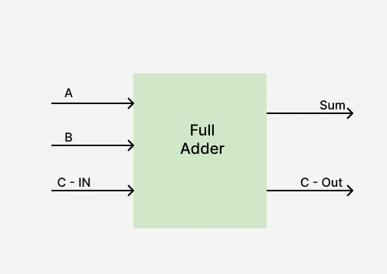
BASIC FULL ADDER
INPUT |  |  | OUTPUT
A | B | C-IN | Sum | C-OUT
0 | 0 | 0 | 0 | 0
0 | 0 | 1 | 1 | 0
0 | 1 | 0 | 1 | 0
0 | 1 | 1 | 0 | 1
1 | 0 | 0 | 1 | 0
1 | 0 | 1 | 0 | 1
1 | 1 | 0 | 0 | 1
1 | 1 | 1 | 1 | 1

Slide 5
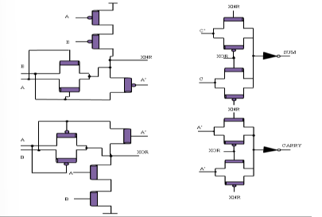
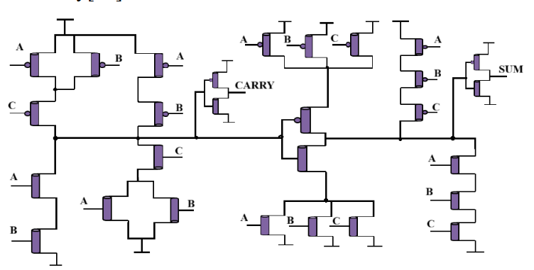
EXISTING FULL ADDER DESIGNS

Slide 6
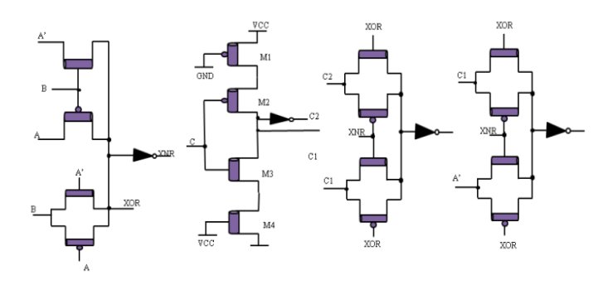
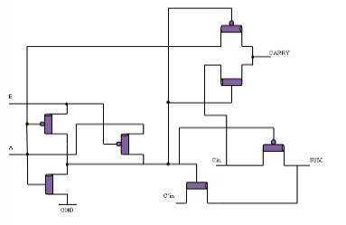
BRIDGE FULL ADDER
GDI BASED FULL ADDER

Slide 7
LIMITATIONS OF EXISTING DESIGNS
High power consumption due to leakage and switching losses
Increased propagation delay because of multiple logic stages
Larger transistor count leading to increased silicon area
Degraded output voltage levels (no full-swing outputs)
Poor noise margin and signal reliability
Limited scalability at nanoscale technologies
Performance degradation under voltage and temperature variations
Higher Power Delay Product and Energy Delay Product

Slide 8
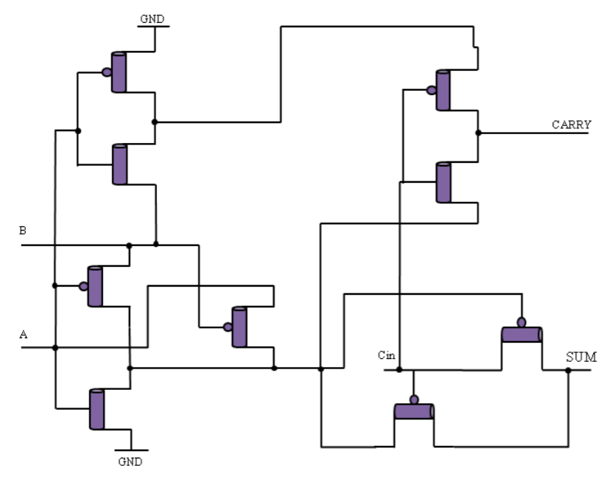
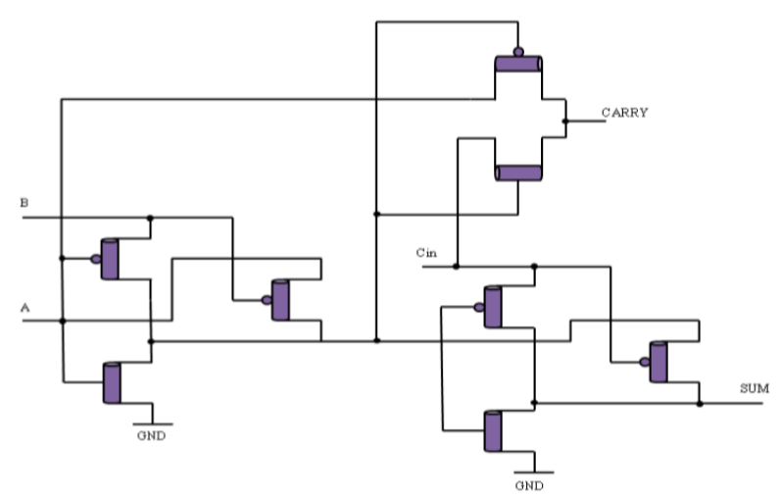
PROPOSED 8T FULL ADDER DESIGNS

Slide 9
PERFORMANCE COMPARISON
FA | Tran. Count | Avg. Power(μW)
CMOS | 28 | 14.24
BFA | 26 | 12.67
9T | 9 | 13.67
Proposed | 8 | 12.29

Slide 10
Advantages
Applications
Less no. of transistors reduces circuit area.
Less power and has low propagation delay.
Shows better energy efficiency with improved PDP and EDP.
Stable performance under voltage and temperature variations.
It can be used in low-power arithmetic circuits.
It is suitable for ALUs in processors and microcontrollers.
The design is useful for CNTFET-based nanoscale VLSI systems.
It is ideal for portable and battery-operated devices.

Slide 11
THANK YOU

